Slide 1
Food image classification
Vivek Agarwal
Manikandan Eswaran
Manish Kumar
Harminder Singh

Slide 2
Introduction
The objective of this project is to train the Scikit-Learn classifiers with images of Entrée, Salad and Dessert dishes and be able to predict if a given image is an Entrée, Salad or Dessert.
The second part of the project is to take any arbitrary image with different food servings on a table and then mark sections of the image containing food.

Slide 3
Test Data
We have collected 100 images each of Entrée, Dessert and Salad from various cuisines from publicly available images.
We have used 100 random images of empty plates, and other images as negative images to train the Scikit-Learn classifier for negative cases.

Slide 4
Classifying images of food using Scikit-Learn
Supervised Learning – SVM/SVC classifier was used as the supervised learner to train and predict randomized sample images of Entrée, Salad and Dessert.
Unsupervised Learning – KMeans classifier was used as the unsupervised learner to train the same images samples without labels.

Slide 5
Image preprocessing
We have used various image processing techniques before training and testing the classifiers.
Image Resizing – All training sample images were resized to 80x80 pixels.
Binary Thresholding – All pixel values greater than a given threshold value were set to a fixed value. This was used to mask backgrounds in images that is not part of food.
Canny - function used for edge detection
Contour Detection – was used to separate out different dishes in a given dining table image with different food servings.
HOG – Feature descriptor to convert image data into histogram data.

Slide 6
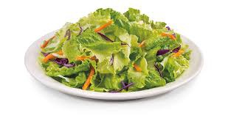
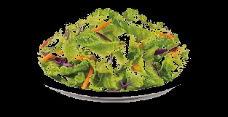
Binary thresholding
Used a preprocessing technique on all the images called binary thresholding in order to eliminate the backgrounds we had in our image and made a new set of images

Slide 7
Unsupervised Image Classification Using KMeans
Resizing the image
Resized the images to 80 X 80 in order to reduce the number of columns we had in our dataset
Hog descriptor
Used the Hog descriptor to get correct information about the image. This contributed to our data set.
New features
Extracted the colors from every image and made three new columns representing the RED, GREEN, BLUE colors.
Algorithm Applied
Applied the K-means algorithm in order to make three clusters which is an unsupervised learning algorithm

Slide 8
Results
 | Cluster 1 | Cluster 2 | Cluster 3
Salad | 63 | 18 | 19
Entrée | 0 | 71 | 22
Dessert | 1 | 30 | 69

Slide 9
Supervised Image Classification Using SVC/Gradient Boosting
Resizing the image
Resized the images to 80 X 80 in order to reduce the number of columns we had in our dataset
Hog descriptor
Used the Hog descriptor to get correct information about the image. This contributed to our data set.
New features
Extracted the colors from every image and made three new columns representing the RED, GREEN, BLUE colors.
Algorithm Applied
Applied the SVM/GB algorithm to train and test the randomized image samples

Slide 10
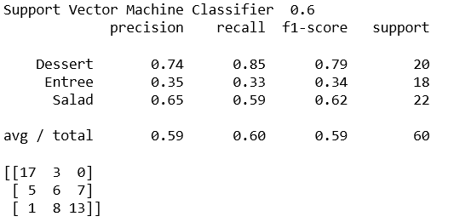
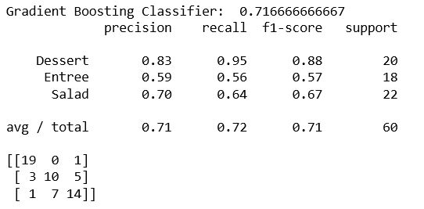
Results

Slide 11
Identifying dishes in a random dining image
Resizing the image
Resize the random image to size 300
Canny Edge Detection
Apply Canny function on resized image to detect edges.
Find Contours
Using OpenCV findContours to collect all image contours in the above image.
Extract Original Image Crops
Crop from the original image using the contour rectangles
Predict Using SVM
Predict the food type using the SVC and the cropped image
Mark on original Image
If the predicted cropped image is a food, mark with a rectangle on the original image

Slide 12
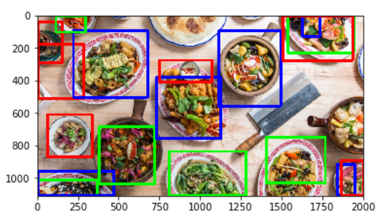
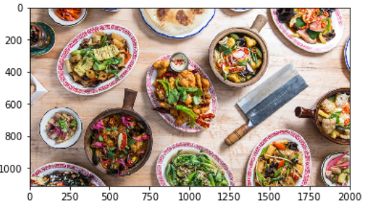
Results

Slide 13
Thank You!

